Slide 1
Introduction toTransformers

Slide 2
Recurrent Neural Networks
RNN / LSTM / GRU work on data in sequential manner
ŷ
V
W
W
W
H₀
H₁
H₂
H₃
U
U
U
x₁
x₂
x₃

Slide 3
Recurrent Neural Networks
RNN / LSTM / GRU work on data in sequential manner
ŷ
V
At each point they look at the current input as well as the information from the past
W
W
W
H
H
H
H
0
1
2
3
U
U
U
x₁
x₂
x₃

Slide 4
Recurrent Neural Networks
RNN / LSTM / GRU work on data in sequential manner
ŷ
V
At each point they look at the current input as well as the information from the past
W
W
W
H
H
H
H
0
1
2
3
U
U
U
Have been quite successful in NLP
x₁
x₂
x₃

Slide 5
Recurrent Neural Networks
Drawbacks:
Due to the sequential nature, it is hard to parallelize RNNs
ŷ
V
W
W
W
H
H
H
H
0
1
2
3
U
U
U
x₁
x₂
x₃

Slide 6
Recurrent Neural Networks
Drawbacks:
Due to the sequential nature, it is hard to parallelize RNNs
Diﬃcult to capture long range dependencies
ŷ
V
W
W
W
H
H
H
H
0
1
2
3
U
U
U
x₁
x₂
x₃

Slide 7
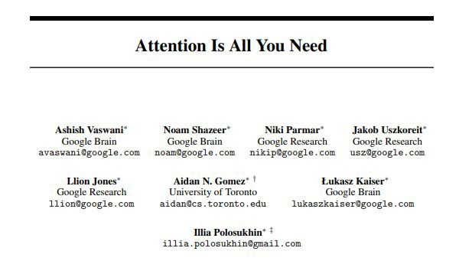
Emergence of Transformer

Slide 8
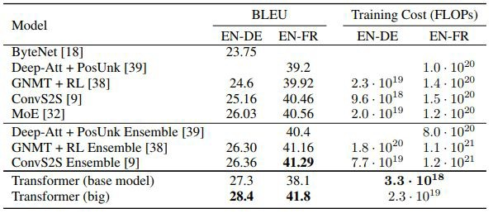
Performance of Transformer
# BLEU, or the Bilingual Evaluation Understudy, is a score for comparing a candidate translation of text to one or more reference translations

Slide 9
Key Highlights
Since 2018, Transformer based models have taken the NLP world by storm.

Slide 10
Key Highlights
Since 2018, Transformer based models have taken the NLP world by storm.
BERT and GPT-2 are two of most important transformer based models.

Slide 11
Key Highlights
Since 2018, Transformer based models have taken the NLP world by storm.
BERT and GPT-2 are two of most important transformer based models.
These models are able to understand the semantics of text to a degree never seen before.

Slide 12
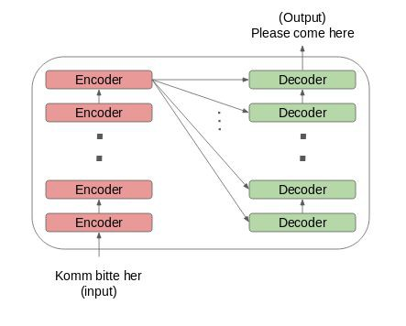
Transformer - Architecture

Slide 13
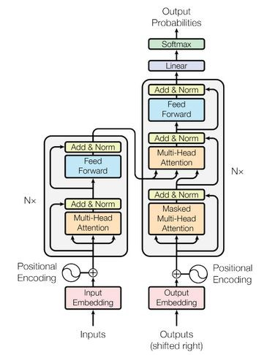
Transformer - Architecture

Slide 14
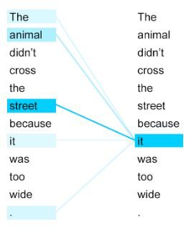
Transformer - Self Attention

Slide 15
Thank You

